Slide 1
UE19CS390A – Capstone Project Review #3
(High Level Design and Proposed Methodology)
Project Title :Recipe Recommendation Based On Ingredients Recognition Using CV AND ML(RRIR)
Project ID :14
Project Guide :Prof Swati Pratap Jagdale
Project Team :A R Manyatha
Amulya Dinesh
Manasi Swain
Mihir Soni

Slide 2
Outline
Abstract
Summary of Literature Survey
Suggestions from Review – 2
Proposed Methodology / Design Approach
Architecture
Design Description
Technologies Used
Project Progress
References

Slide 3
Abstract
We will be creating a recipe recommendation system using pictures/videos of the pantry for a variety of uses. Camera will be used to scan the ingredients present in the pantry and provide the user with all the dishes and recipes possible. User has an option to specify the type of diet along with calorie range.

Slide 4
Abstract
The main objective of the proposed system is to assist users to decide what they can cook with the available resources. By pointing the camera at the food ingredients, users can immediately build a plan or have an idea of what they will be cooking, based on our recommendations along with the nutritional value of the recipe.
There are three main parts to this project: Computer vision to scan the ingredients; Machine learning to label the ingredients; to search the database for recipes from the dataset based on the ingredients, if the recipe is not present, perform web scraping.

Slide 5
Summary of Literature Survey in Review 2
The models used to implement the problem statements in the papers mainly include:
Feature extraction and selection: Deep learning models such as CNN , FNN, SVM, PCA (Principal Component Analysis), CFS (Correlation Feature Selection), IG (Information Gain)
Feature classification : Non linear SVM kernals, Cumulative Knowledge-based Regression Models (CKRM), CNN

Slide 6
Suggestions from Review – 2
Provide the suggestions and remarks given by the Guide.
To finalise the type of application to be implemented
To explore feasible options for diet type
Mention the feasibility on the same showing the progress.
Type of application - mobile application
Feasible options for diet type - veg, non-veg, vegan,keto and diabetic diet

Slide 7
Design Details
Novelty
Our project not only focuses on recommending a recipe list, but also, caters to the needs of the user by considering diet choice and calorie range. As far as our literature survey is concerned, we haven't come across any project which considered the type of diet along with calorie count. This will be inculcated into our project to make it more practical for everyday use.
Reliability
The model requires a server with high speed internet capability. The user should be equipped with fair network bandwidth to send images and receive recipes

Slide 8
Design Details
Performance
Availability: The server should be available on specified time as many users are waiting for the recipe to be generated .
Correctness: Accurate recipes should be recommended to the user in real time.
Usability: The model should handle multiple requests from multiple users.
Reusability
Object detection is the first phase of our project that can be reused. On training the model on different datasets, it can be able to identify different kinds of objects other than food ingredients. Hence, object detection algorithm can be reused.

Slide 9
Design Details
Security
Authentication of user whenever he/she logs into the system. The users will have private user profiles which will store user information.We will have a user-id and a password for authentication which will be logged in in the mobile application.
Maintainability
The administrators should ensure that the server is up and running and not overloaded, ensuring it is well maintained.

Slide 10
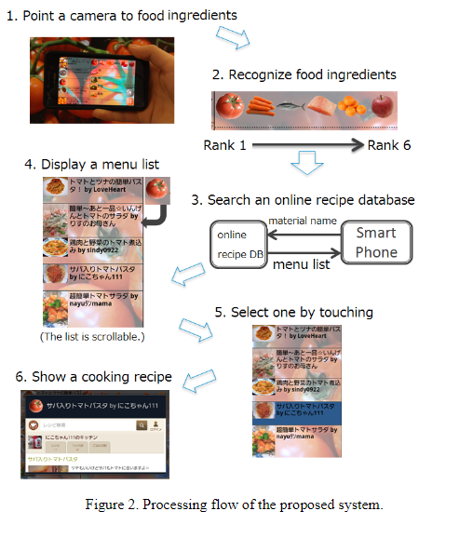
Proposed Methodology / Approach
Approach 1:
This approach proposed a cooking recipe recommendation system by employing object recognition for food ingredients such as vegetable and meat. By pointing mobile phone camera towards food ingredients, a user receives a recommendation list instantly.This system uses color-histogram and bag-of-features with SURF (Speeded Up Robust Features) extracted from multiple frames as an image representation and a linear kernel SVM as a classifier.
Image source

Slide 11
Proposed Methodology / Approach
Is there a need for changing the approach?
Yes,
Improvement of the user interface and also considering the calorie count,nutrition of ingredients
Implement recipe search considering combination of multiple food ingredients
SURF algorithm has many disadvantages such as high dimension of feature descriptor, large amount of computation, and low matching accuracy

Slide 12
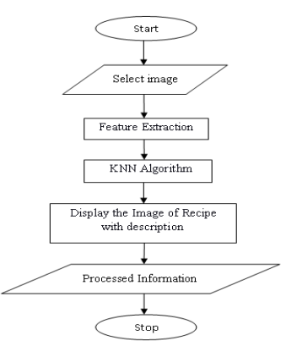
Proposed Methodology / Approach
Approach 2:
This approach proposes a cooking Recipe Retrieval System. The system proposed, does the real time
recognition of the ingredient by name or image. It helps a user to retrieve set of recipes including those food
ingredients. This system also provides the facility for the user to view the images of ingredients. The system is developed using MATLAB. Harris Corner Detector, K-Nearest Neighbor technique and Scale Invariant Feature Transformer (SIFT) are used to build this system.
Image Source

Slide 13
Proposed Methodology / Approach
Is there a need for changing the approach?
Yes,
The implementation uses web application, which is not necessarily user friendly (compared to mobile app)
The ingredients must be selected from a drop down list and object detention is not done using camera.
KNN does not work well with large dataset as calculating distances between each data instance would be very costly.

Slide 14
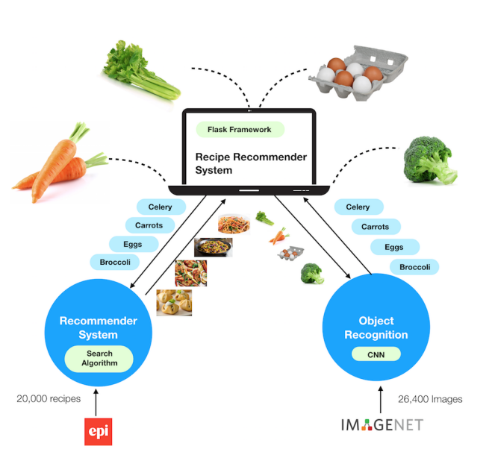
Proposed Methodology / Approach
Approach 3:
This approach proposes a recipe recommendation system employing image recognition of food ingredients, specifically vegetables. The system is a web application that performs image recognition on the uploaded images and recommends recipes that contains the recognized ingredients. It has a convolutional neural network (CNN) model
for image recognition to identify five categories of food ingredients.
Image Source

Slide 15
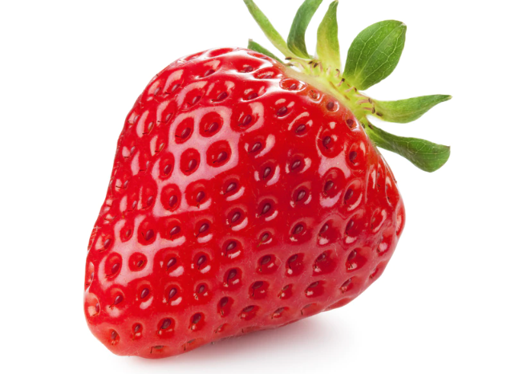
Proposed Methodology / Approach
Is there a need for changing the approach?
Yes,
Diet and nutrition constraints are not considered
CNN is single labeled, each picture will have only one ingredient
The user is not given an option to upload video.
Single labeled CNN
Strawberry

Slide 16
Proposed Methodology / Approach
Basic Approach and results obtained
Recipe recommendation system by employing object recognition for food ingredients such as vegetable, fruits and meat. By pointing mobile phone camera towards food ingredients, a user receives a recommendation list.
Proposed models:
OpenCV: extract video frames and saves images using Python
CNN: 1. Feature Extraction
2. Multi-label Image Classification

Slide 17
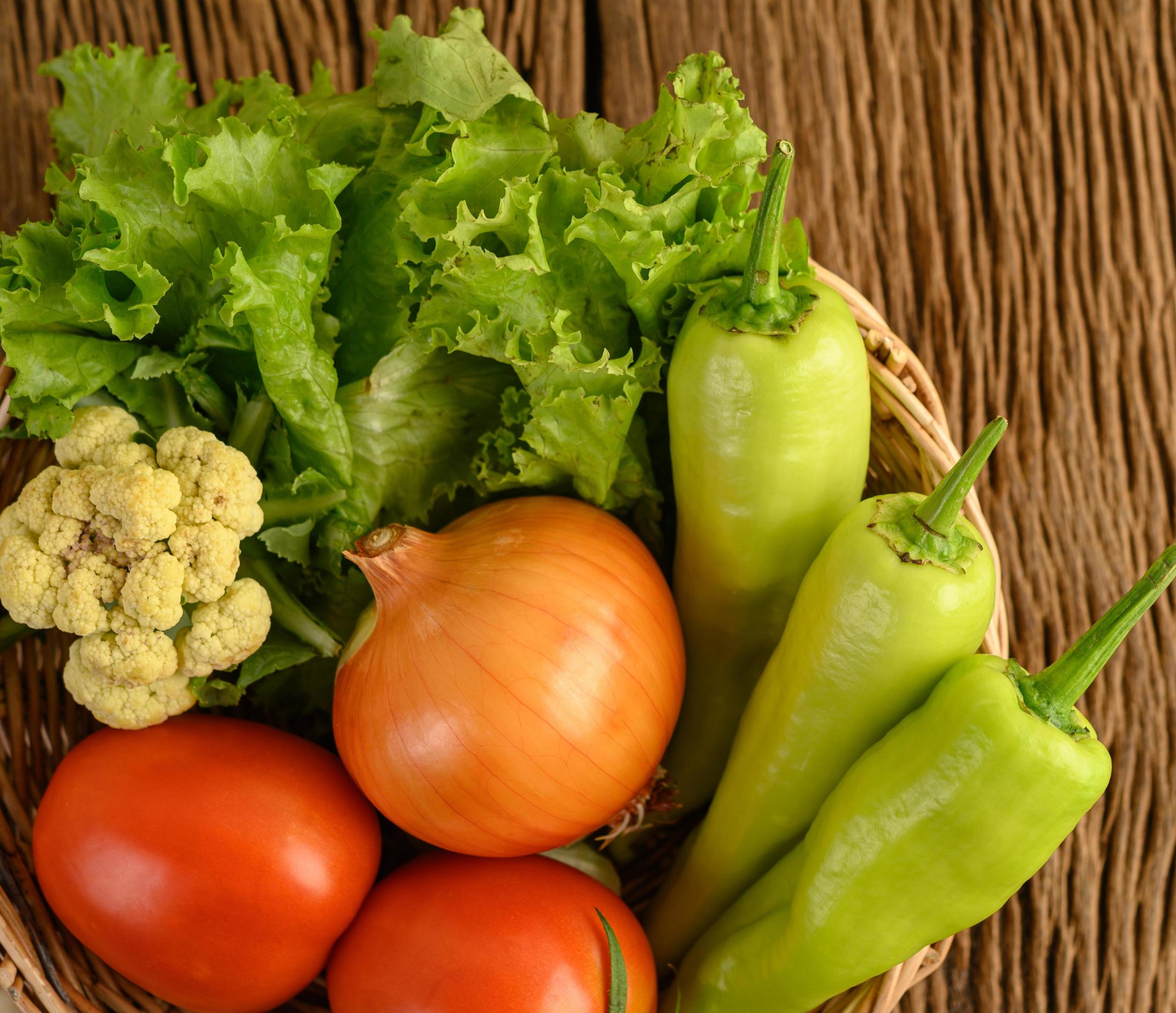
Proposed Methodology / Approach
Lettuce
Chilli
Multi-label Image Classification using CNN
Onion
Tomato
Cauliflower

Slide 18
Proposed Methodology / Approach
2. Is there a need for changing the approach?
No, there is no need for change in the proposed approach as of now. As per our literature survey, these models are best suited for our project and yields good results.
We may have to change it in the future if we experience any unforeseen situations.

Slide 19
Proposed Methodology / Approach
3. Details of the new approach- benefits/drawbacks
Benefits: Variety of recipe lists which match the user requirements are recommended. Large number of ingredients are considered while training the model.
Drawbacks: Huge dataset might lead to more processing time and resource consumption.

Slide 20
Architecture
Choice of Architecture considered : Layered (n-tier) architecture
This architecture can be used to structure programs that can be decomposed into groups of subtasks, each of which is at a particular level of abstraction. Each layer provides services to the next higher layer.

Slide 21
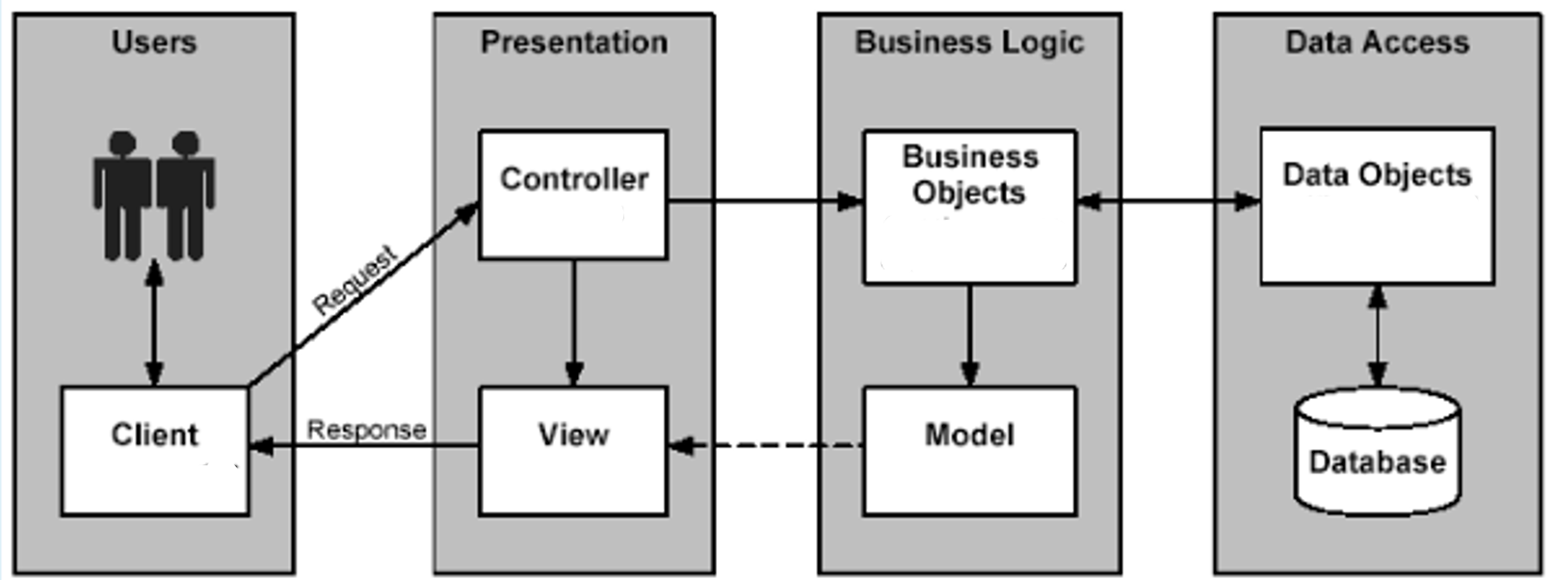
Architecture

Slide 22
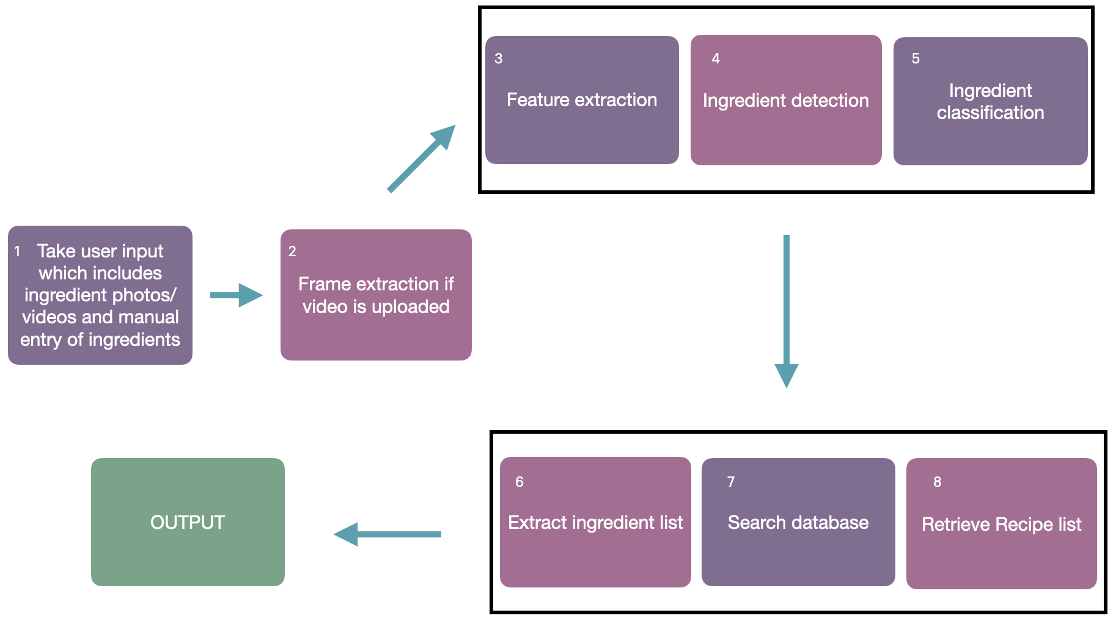
Architecture

Slide 23
Design Description (if applicable)
Master class diagram
ER Diagram
User Interface Diagrams/ Use Case Diagrams
External Interfaces

Slide 24
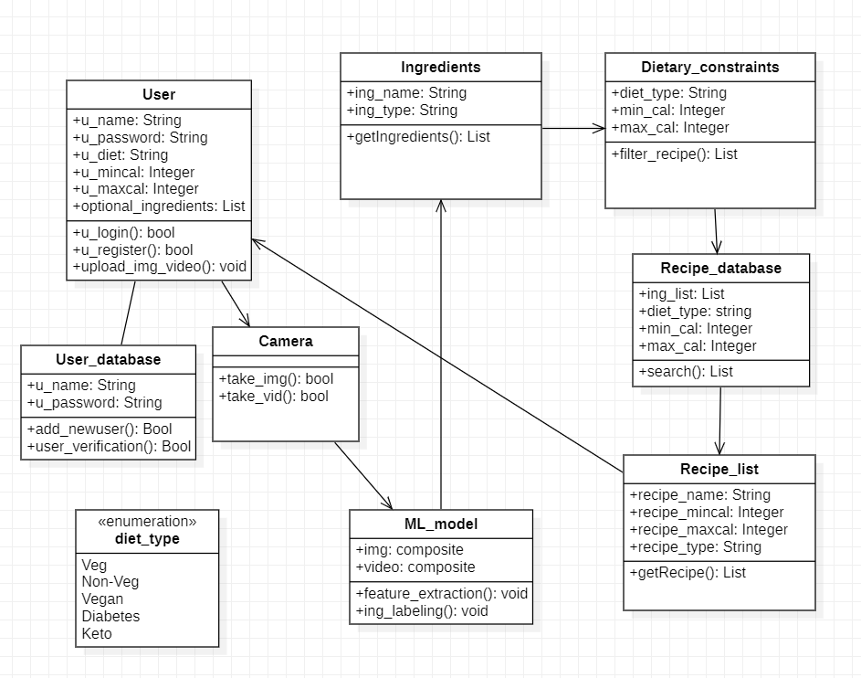
MASTER CLASS DIAGRAM

Slide 25
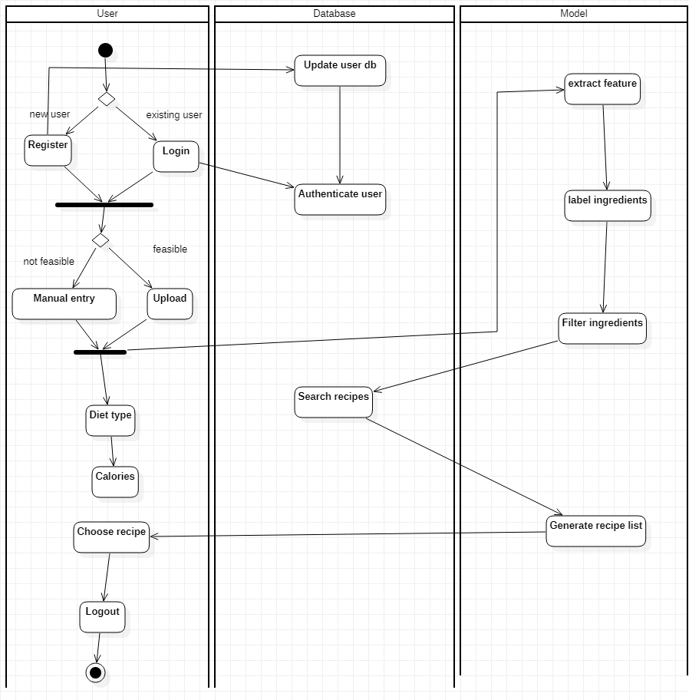
SWIMLANE DIAGRAM

Slide 26
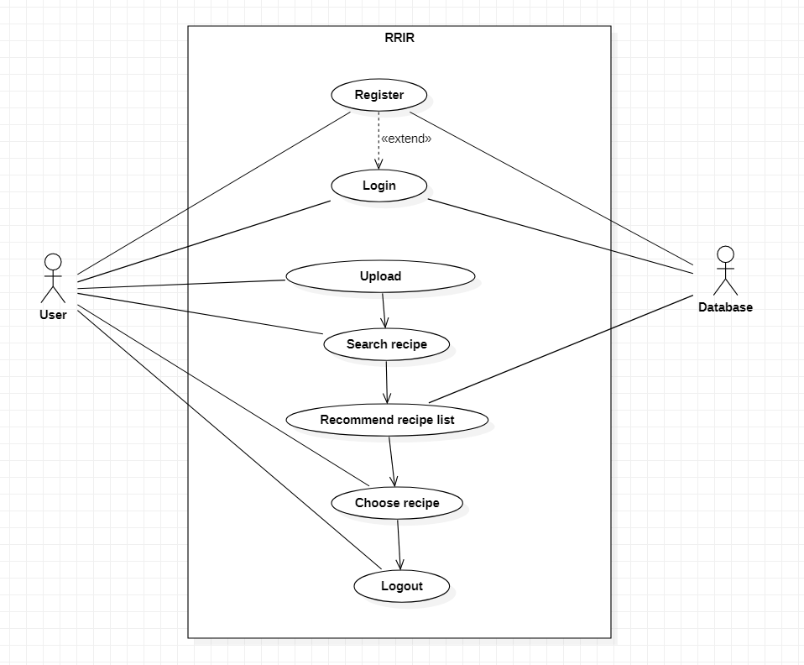
USE CASE DIAGRAM-1

Slide 27
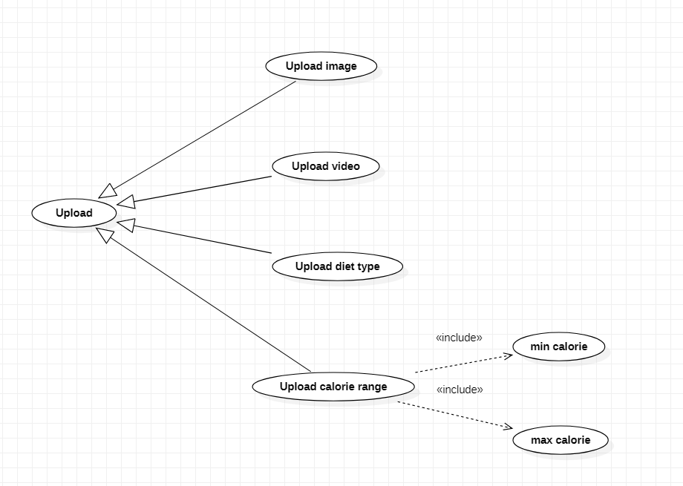
USE CASE DIAGRAM-2

Slide 28
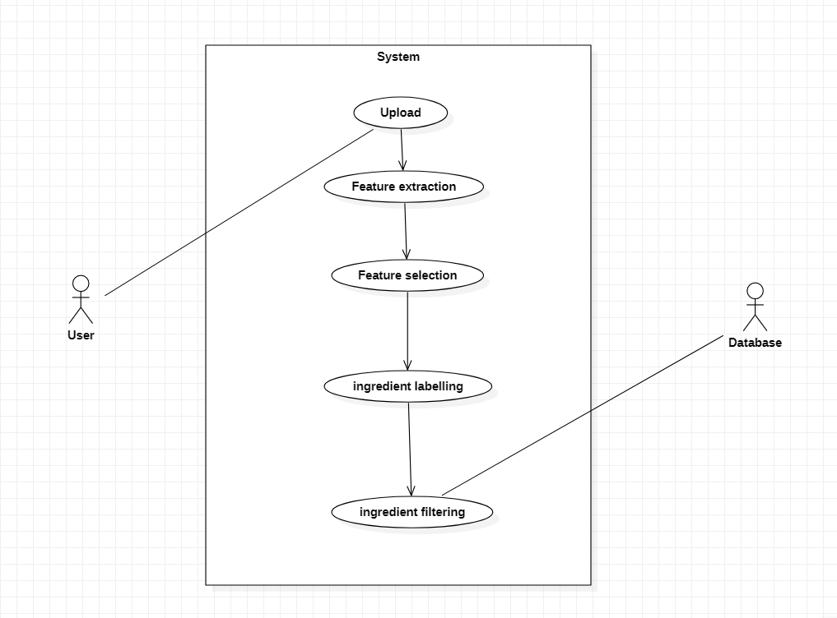
USE CASE DIAGRAM-3

Slide 29
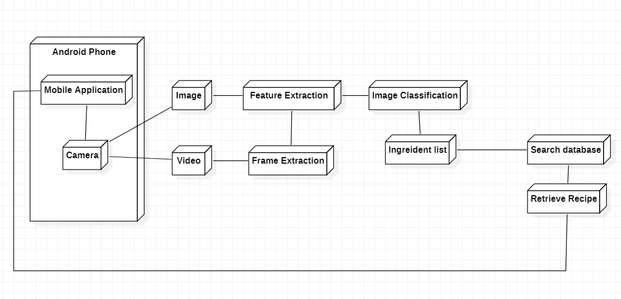
DEPLOYMENT DIAGRAM

Slide 30
Technologies Used
TensorFlow - an open-sourced a library of Google that is utilized in Android for implementing Machine Learning.
TensorFlow Lite - TensorFlow’s lightweight solution for mobile devices. It enables on-device ML inference using a low latency which is why it is very swift.
OpenCV - programming functions mainly aimed at real-time computer vision (cv2.VideoCapture)
Keras - a Python deep learning library, to re-train the top fully-connected layer of CNN.

Slide 31
Project Progress
Literature survey pertaining to various models and approaches studied and analysed so far.
Understanding the user environment to design a compatible user interface.
Finalising on the best working models for the functionalities to perform their best.

Slide 32
Capstone (Phase-I & Phase-II) Project Timeline
Provide
The timelines for execution of the project through Gantt chart.
The plan in terms of efforts by individuals in the team.
Mention the tasks involved in different stages.

Slide 33
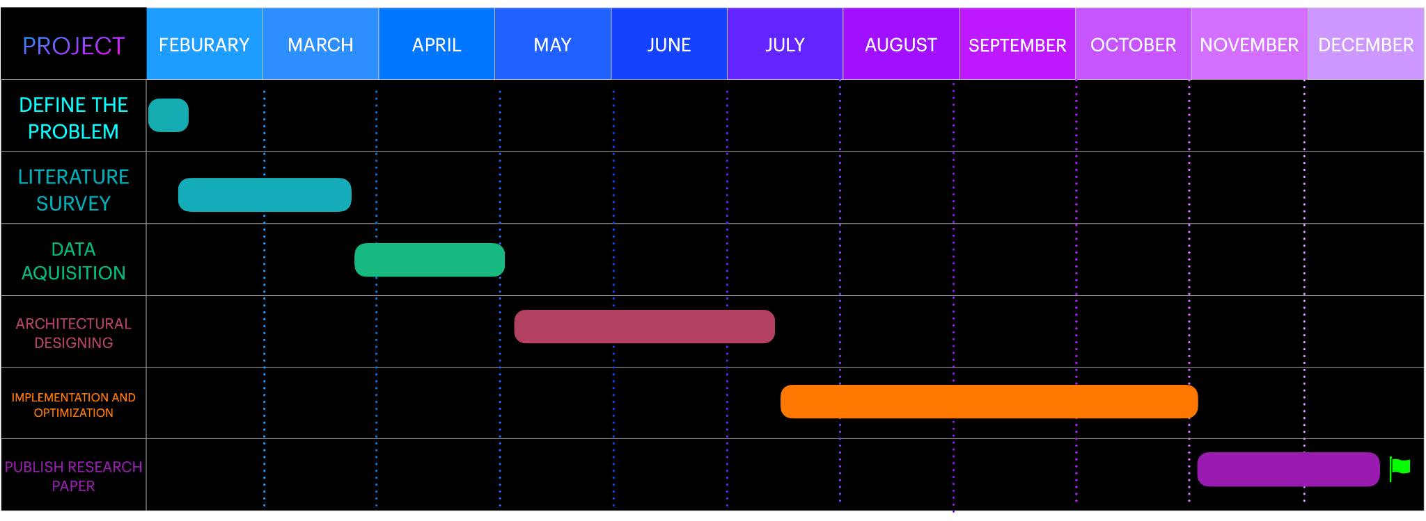
Capstone (Phase-I & Phase-II) Project Timeline
GANTT CHART

Slide 34
Capstone (Phase-I & Phase-II) Project Timeline
The plan in terms of efforts by individuals in the team:
Everyone will participate in pair programming
Everyone will be doing their individual research and will be briefing everyone about it.

Slide 35
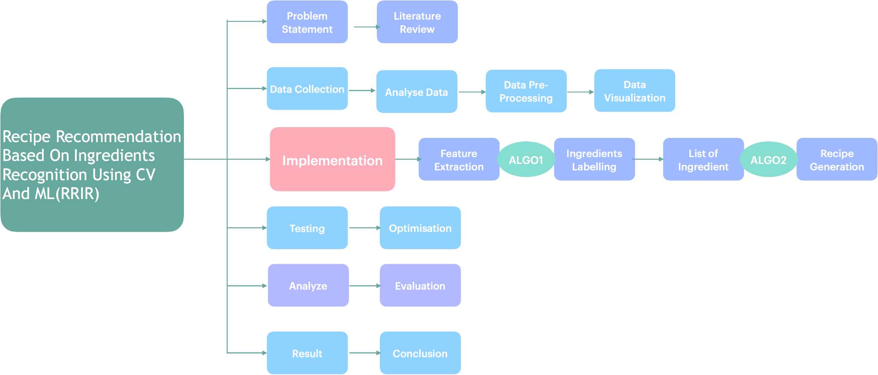
Capstone (Phase-I & Phase-II) Project Timeline

Slide 36
Conclusion
Summarize the key points.
Computer Vision - We use a camera to scan the ingredients present in the pantry.
Machine Learning - In machine learning, data labeling is done. The ingredients scanned by using CV are now labeled using ML models for accurate results .

Slide 37
Conclusion
Search Database- The recipe for the list of labeled ingredients obtained from the above steps is searched from the predefined database. If the ingredients do not match with the existing data, web scraping is performed. The list of recipes which meet the requirements are returned to the user, to choose from.
Mobile Application - A simple UI will be created where the user can login and create an account. Once logged in, the user can upload the images of ingredients. These images are processed and the list of suitable recipes are recommended. Additionally, the calories of each recipe will be displayed.

Slide 38
References
Keiji Yanai, Takuma Maruyama, Yoshiyuki Kawano, “A Cooking Recipe Recommendation System with Visual Recognition of Food Ingredients”, 2014
Gangothri R. Sanil , Anusha Anchan , Vijetha Achar, Kavya Hegde, “KNN based Recipe Retrieval using Ingredient Recognition”, 2018

Slide 39
Thank You

